Slide 1
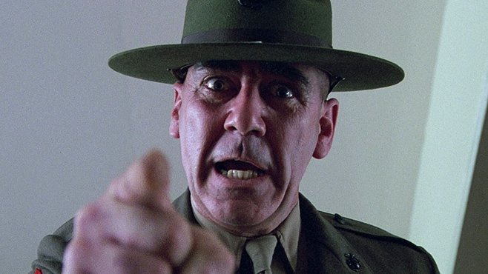
Welcome to Hell!
(just kidding)
University of California, San Diego -- Coding Bootcamp

Slide 2
Introductions
Jeffrey Jones Instructor
Chris Parsoneault Teaching Assistant
Notes:
CRITICAL 20m -- 7:10
Questions for us?

Slide 3
What we've done
Notes:
refworks
chris talk (doesn't work on anything public)

Slide 4
Why are we all here?
Form small groups, and chat with each other.
Create a persona that represents your group, and your interests.
And, what are your top 3 reasons for joining the boot camp?
Notes:
Group: introduce yourselves, tell us about your persona.
Talk about why we're here too, that we want to see them succeed.

Slide 5

Difficult times ahead
We have tons to learn! And, time is short...
You're going to get frustrated, be confused, and feel hopeless.
It means you're learning
This is a life of learning, technology constantly reinvents itself.
Acquire a love for learning.
Notes:
CRITICAL 25m -- 7:30
Circle of learning

Slide 6
Difficult times ahead
Be curious! Find new things to learn.
Do a lot of stuff (not just read about it). You need practice.
Be persistent and passionate.
As of today, you're a blank canvas, time to start painting.
Notes:
Only can't learn if you don't want to. It's persistence and desire.

Slide 7

Life happens
We've got six months together.
Issues will come up in your personal life.
You'll have to balance work, life, and this.
Finding motivation will be hard at times.
Notes:
Let you SSM know when things are happening. Let them help you. Talk to us, and each other.

Slide 8
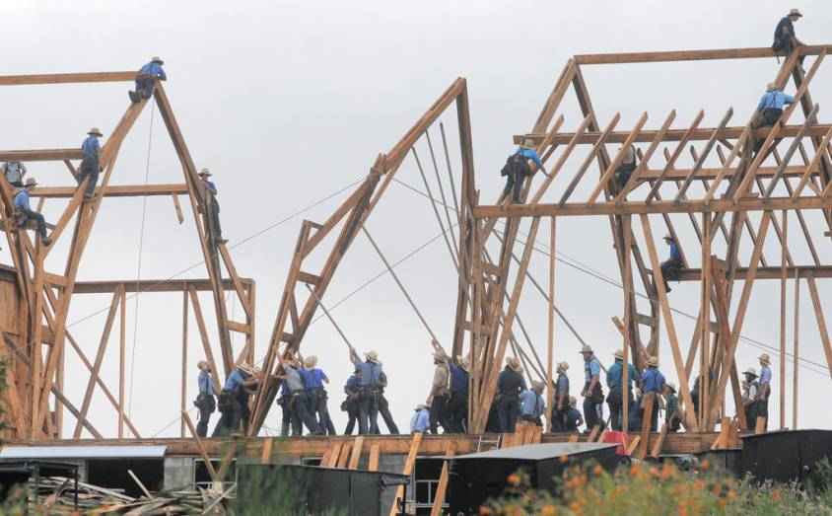
It works better when we work together
We're the first connections in your developer network.
We can help each other in so many ways!

Slide 9
It works better when we work together
We're the first connections in your developer network.
We can help each other in so many ways!
A second set of eyes is a blessing.
Today you might be the teacher, tomorrow the student.
Notes:
Make connections with the people around you. Remember them. Connect on linkedin. Stacey: What's the easiest way to find a job? (referral). Managers will ask you if you know any good developers. Remember us, and be a good developer :)

Slide 10
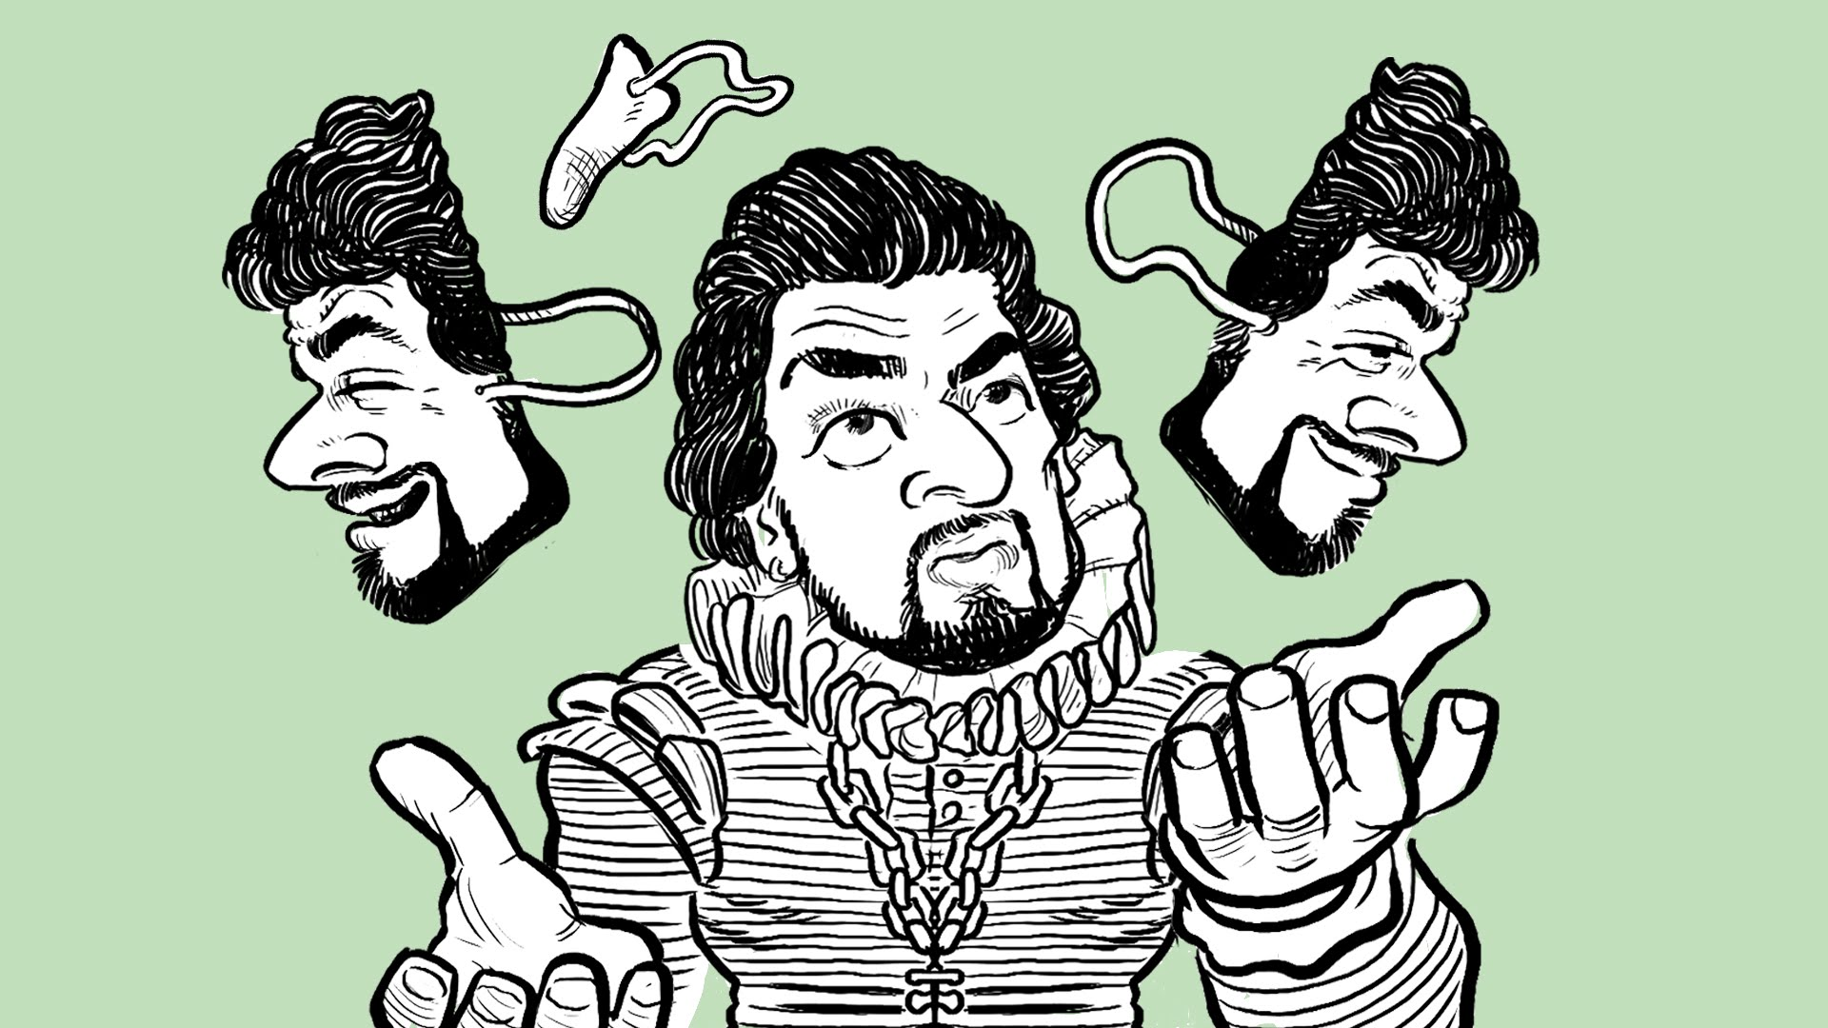
To thine own self be true
Reflect on your successes and how far you've come.
Retrospect on your failures, what can you learn.
Trust yourself.
Let your exertion match your expectations.
Notes:
You're not going to land that job at Google/Amazon/Facebook/whatever unless you put in that amount of effort. No effort = coffee intern.

Slide 11

Learning to learn
Someone has already suffered this, and they posted it online.
Google knows [almost] everything.
People will answer your questions. stackoverflow.com!
Stackoverflow isn't just for asking questions, give back.
Experiment, we're all scientists. Hypothesis, test, revise and repeat.
Notes:
Giving back pays interest. Employers will actually look at your stackoverflow profile.
How do you learn best?

Slide 12
What troubles you?
Form small groups, and chat with each other.
What's a problem you think you'll encounter?
How can you address it?
Discuss...
Notes:
Group up: new groups

Slide 13
Pre-work Checklist
Chrome
Slack
Sublime Text
Command Line
Git, Github, Gitlab
Heroku
Notes:
CRITICAL 25m -- 7:55
Get raise of hands on complete. Help (and have students help) where people are struggling.
Break after

Slide 14
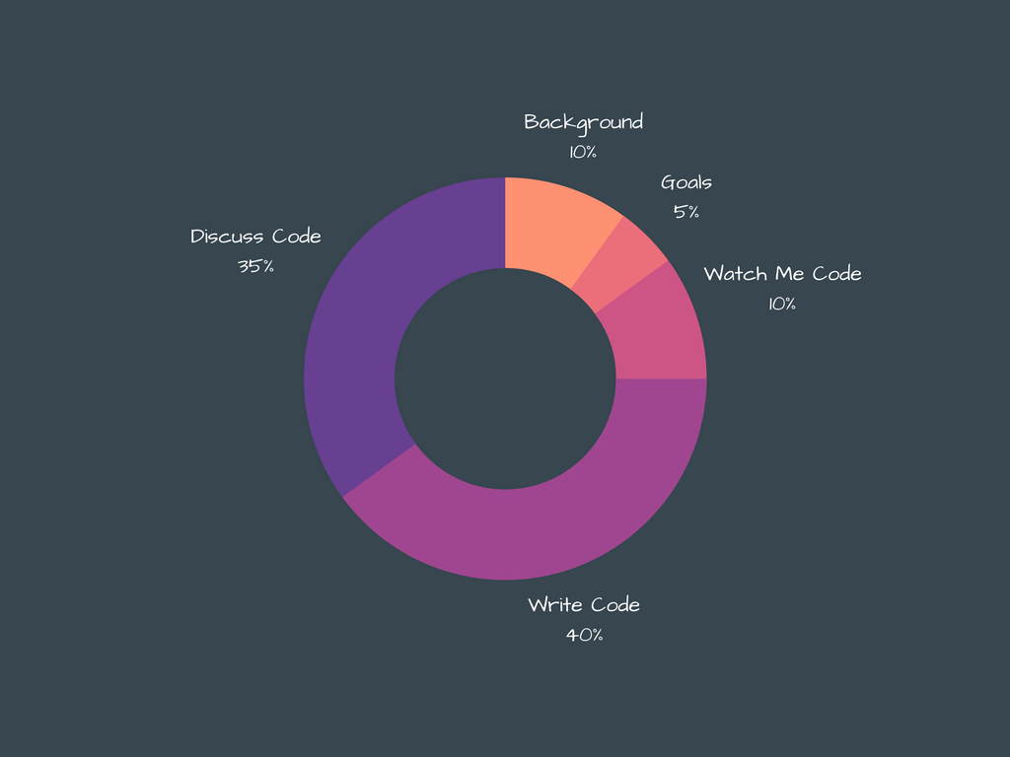
What's class really going to be like?
Notes:
HIGH 5m -- 8:35

Slide 15
The modern web
What's a website you frequent?
How does it actually work?
Discuss.
Notes:
10m
Group up: new groups.
Explain the web (draw on board). Fist - 5 (you don't get it so much you're shaking your fist in anger)

Slide 16
Full stack… What?
What do you think a full stack developer is?
Notes:
5m -- 8:50

Slide 17
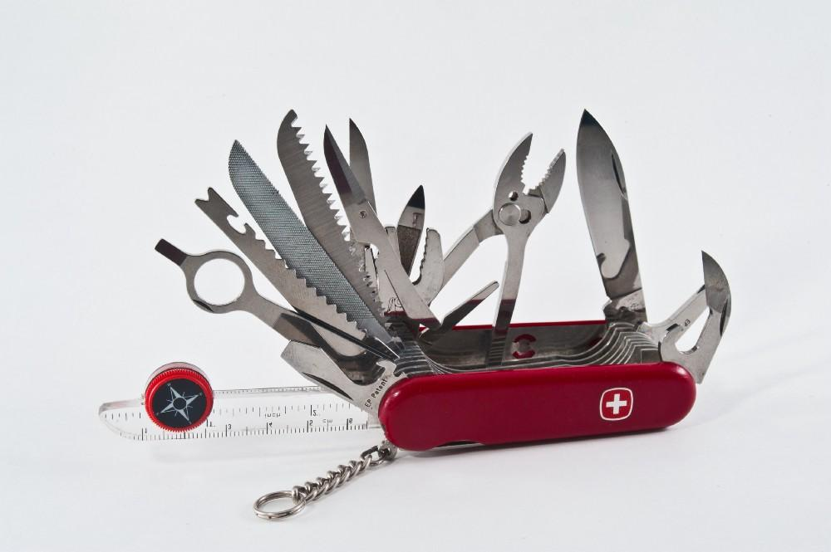
Full stack… What?
What do you think a full stack developer is?
Does not believe in "I can't".
I'm full stack, I can do anything!
Notes:
"specialists" a good "front-end" developer is actually just a specialized full stack developer. It's not that they can't do back-end or database. They can, but they are focusing all their learning on front-end.

Slide 18
The command line
Why use this command line thing at all? There is UI to do this right here!
Discuss.
Notes:
15m -- 8:55

Slide 19
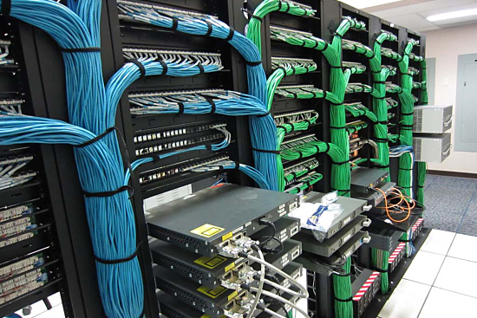
The command line
Do you think these things have pretty user interfaces for you to use?
Would they waste resources on an interface that is hardly ever seen?

Slide 20
The command line
Let's start with some structure.
A modern website clearly has many components.
Wouldn't it be nice to organize them?
Let's try together!
Notes:
Quick run through, then ask them to complete it locally. Ask / help neighbors get setup and understand.
At end fist to 5

Slide 21
The structure and foundation: HTML
Your turn.
DOCTYPE declaration
head with title
header
image
links (use target="_blank" for external)
Bonus points for: ordered list, unordered list, tables, separate links horizontally, embed a video, other html stuff - have fun!
Notes:
15m -- 9:10
Build a page talking about themselves.

Slide 22
Additional resources
Making an HTML page
Layout using CSS
Floats in CSS
Positioning in CSS
Layout using positioning in CSS

Slide 23
Homework
This is your first gig as a software developer, you're hiring yourself to build a portfolio!
You're building your brand, this will be how you impress those hiring managers.
Invest in your brand, spend some time here. Come back to this project again and again.
Update your portfolio as your skills grow.
Notes:
5m
Not assigned until Saturday!

